Slide 1
Computer Networks
Lecture-09 & 10

Slide 2
Recap of Lecture 8
Unguided Media
Propagation methods
Radio Frequency Allocation
  Radio Waves
  Microwave
  Infrared
Media Comparison

Slide 3
Overview of Lecture
Multiplexing
  Frequency division multiplexing
  Wave division multiplexing
  Time division multiplexing
    Synchronous TDM
    Asynchronous or Statistical TDM

Slide 4
Multiplexing
Under the simplest conditions, a medium can carry only one signal at any moment in time.
For multiple signals to share one medium, the medium must somehow be divided, giving each signal a portion of the total bandwidth.
“Set of techniques that allows the simultaneous transmission of multiple signals across a single data link”

Slide 5
Multiplexing
As the data communication’s usage is increasing, the traffic is also increasing. People are exchanging more and more data to each other.
When the traffic increases there are two possible solutions to control/handle the traffic.
  Add a new line whenever there is a new channel (device) added to the system.
  Or install a higher capacity link and use each link to carry multiple signals.
  (“share the capacity of the link !”)

Slide 6
Multiplexing
Today's technology includes high-bandwidth media such as optical fiber and terrestrial and satellite microwaves.
Each has a bandwidth far in excess of that needed for the average transmission signal.
If the bandwidth of a link is greater than the bandwidth needs of the devices connected to it, the bandwidth is wasted.
An efficient system maximizes the utilization of all resources; bandwidth is one of the most precious resources we have in data communications.
In a multiplexed system, n lines share the bandwidth of one link.

Slide 7
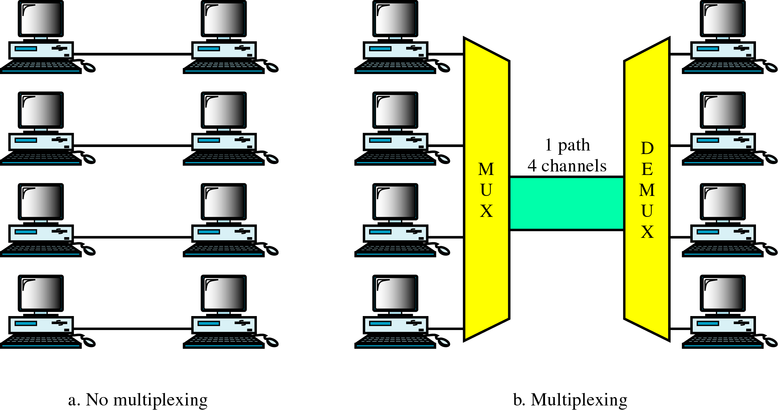
Multiplexing

Slide 8

Dividing a link into channels

Slide 9
Categories of Multiplexing

Slide 10

Categories of Multiplexing

Slide 11
Frequency Division Multiplexing
FDM is an analog technique that can be applied when the bandwidth of a link (in hertz) is greater than the combined bandwidths of the signals to be transmitted.
In FDM, signals generated by each sending device modulate different carrier frequencies.
These modulated signals are then combined into a single composite signal that can be transported by the link.
Carrier frequencies are separated by sufficient bandwidth to accommodate the modulated signal.

Slide 12
Frequency Division Multiplexing
Channels can be separated by strips of unused bandwidth-guard bands-to prevent signals from overlapping.
In addition, carrier frequencies must not interfere with the original data frequencies.
We consider FDM to be an analog multiplexing technique; however, this does not mean that FDM cannot be used to combine sources sending digital signals.
A digital signal can be converted to an analog signal before FDM is used to multiplex them.

Slide 13

Frequency Division Multiplexing

Slide 14
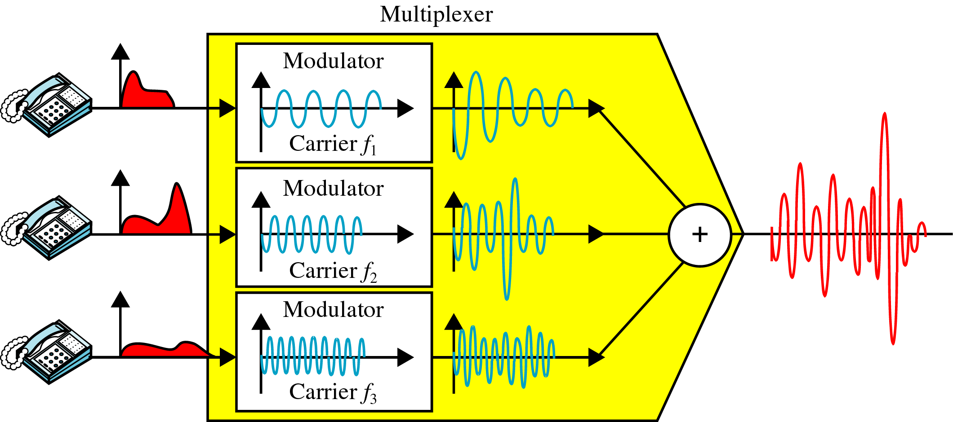
Multiplexing Process
Notes:
Modulation is the process of converting data into radio waves by adding information to an electronic or optical carrier signal. A carrier signal is one with a steady waveform -- constant height, or amplitude, and frequency.

Slide 15
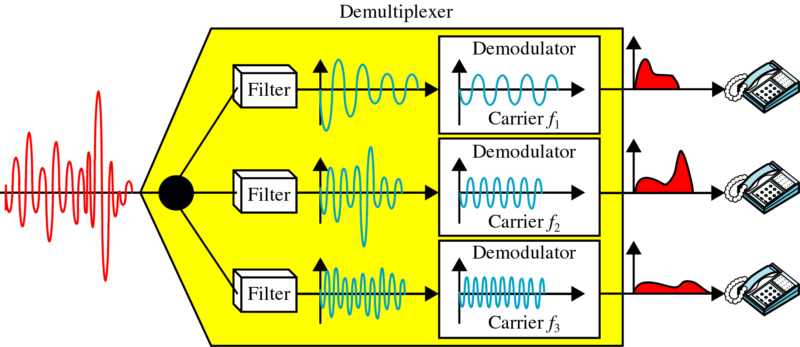
De-multiplexing Process

Slide 16
Example 1
Assume that a voice channel occupies a bandwidth of 4 kHz.
We need to combine three voice channels into a link with a bandwidth of 12 kHz, from 20 to 32 kHz.
Show the configuration, using the frequency domain. Assume there are no guard bands.
Solution
We shift (modulate) each of the three voice channels to a different bandwidth, as shown in Figure 6.6. We use the 20- to 24-kHz bandwidth for the first channel, the 24- to 28-kHz bandwidth for the second channel, and the 28- to 32-kHz bandwidth for the third one. Then we combine them as shown in Figure.

Slide 17

Example 1

Slide 18
Example 2
Five channels, each with a 100-kHz bandwidth, are to be multiplexed together. What is the minimum bandwidth of the link if there is a need for a guard band of 10 kHz between the channels to prevent interference?
Solution
For five channels, we need at least four guard bands. This means that the required bandwidth is at least
5 × 100 + 4 × 10 = 540 kHz,
as shown in Figure

Slide 19

Example 2

Slide 20
Applications of FDM
A very common application of FDM is AM and FM radio broadcasting.
Radio uses the air as the transmission medium. A special band from 530 to 1700 kHz is assigned to AM radio.
All radio stations need to share this band.
Each AM station needs 10kHz of bandwidth.
Each station uses a different carrier frequency, which means it is shifting its signal and multiplexing.
The signal that goes to the air is a combination of signals.
A receiver receives all these signals, but filters (by tuning) only the one which is desired.
Without multiplexing, only one AM station could broadcast to the common link, the air.

Slide 21
Applications of FDM
The situation is similar in FM broadcasting. However, FM has a wider band of 88 to 108 MHz because each station needs a bandwidth of 200 kHz.
Another common use of FDM is in television broadcasting. Each TV channel has its own bandwidth of 6 MHz.
The first generation of cellular telephones (still in operation) also uses FDM.
Each user is assigned two 30-kHz channels, one for sending voice and the other for receiving.
The voice signal, which has a bandwidth of 3 kHz (from 300 to 3300 Hz), is modulated by using FM.

Slide 22
Wave Division Multiplexing

Slide 23
Wave Division Multiplexing
WDM is designed to use the high-data-rate capability of fiber-optic cable (high data rate as compare to metallic transmission cable).
Using a fiber-optic cable for one single line wastes the available bandwidth.
Multiplexing allows us to combine several lines into one.
WDM is conceptually the same as FDM, except that the multiplexing and de-multiplexing involve optical signals transmitted through fiber-optic channels.

Slide 24
Wave Division Multiplexing
The idea is the same: We are combining different signals of different frequencies.
The difference is that the frequencies are very high.
Figure gives a conceptual view of a WDM multiplexer and de-multiplexer.
Very narrow bands of light from different sources are combined to make a wider band of light.
At the receiver, the signals are separated by the de-multiplexer.

Slide 25
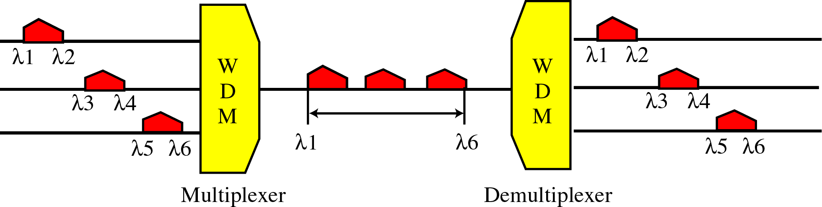

Wave Division Multiplexing

Slide 26

Prisms in WDM

Slide 27
Time Division Multiplexing

Slide 28
Time Division Multiplexing
Portions of signals occupy the link sequentially
Sharing of the signal is accomplished by dividing available transmission time on a medium among users.
Digital signaling is used exclusively. However, this does not mean that the sources cannot produce analog data; analog data can be sampled, changed to digital data, and then multiplexed by using TDM.
Time division multiplexing comes in two basic forms:
  Synchronous TDM
  Statistical, or asynchronous TDM.

Slide 29

Time Division Multiplexing

Slide 30
Synchronous TDM
Multiplexer allocates exactly the same time slot to each device at all times even if it is not sending data
Very popular
Line will require as much bandwidth as all the bandwidths of the sources.
The original time division multiplexing.
The multiplexor accepts input from attached devices in a round-robin fashion and transmit the data in a never ending pattern.

Slide 31
Synchronous TDM
The data flow of each input connection is divided into units, where each input occupies one input time slot.
A unit can be 1 bit, one character, or one block of data.
Each input unit becomes one output unit and occupies one output time slot.
However, the duration of an output time slot is n times shorter than the duration of an input time slot.
If an input time slot is T sec, the output time slot is T/n sec, where n is the number of connections.
In other words, a unit in the output connection has a shorter duration; as it travels faster.

Slide 32
Synchronous TDM
In synchronous TDM, a round of data units from each input connection is collected into a frame.
If we have n connections, a frame is divided into n time slots and one slot is allocated for each unit, one for each input line.
In Figure , the data rate of the link is 3 times the data rate of a connection; likewise, the duration of a unit on a connection is 3 times that of the time slot (duration of a unit on the link).
This is just to convey the idea that each unit is 3 times longer in duration before multiplexing than after.

Slide 33

Synchronous TDM

Slide 34
Example 1
In Figure the data rate for input connection is 1 kbps. If 1 bit at a time is multiplexed (a unit is 1 bit), what is the duration of (a) each input slot, (b) each output slot, and (c) each frame?
Solution
a. The data rate of each input connection is 1 kbps. This means that the bit duration is 1/1000 s or 1 ms. The duration of the input time slot is 1 ms (same as bit duration).
b. The duration of each output time slot is one-third of the input time slot. This means that the duration of the output time slot is 1/3 ms.
c. Each frame carries three output time slots. So the duration of a frame is 3 × 1/3 ms, or 1 ms. The duration of a frame is the same as the duration of an input unit.

Slide 35
Interleaving
TDM can be visualized as two fast-rotating switches, one on the multiplexing side and the other on the de-multiplexing side.
The switches are synchronized and rotate at the same speed, but in opposite directions.
On the multiplexing side, as the switch opens in front of a connection, that connection has the opportunity to send a unit onto the path.
This process is called interleaving.
On the de-multiplexing side, as the switch opens in front of a connection, that connection has the opportunity to receive a unit from the path.

Slide 36

Interleaving

Slide 37

Empty Slots
Synchronous TDM is not as efficient as it could be.
If a source does not have data to send, the corresponding slot in the output frame is empty. Figure 6.18 shows a case in which one of the input lines has no data to send and one slot in another input line has discontinuous data.

Slide 38
Data rate management
One problem with TDM is how to handle a disparity in the input data rates.
Up till now we assumed that the data rates of all input lines were the same.
However, if data rates are not the same, three strategies, or a combination of them, can be used.
  Multilevel multiplexing,
  Multiple-slot allocation, and
  Pulse stuffing.

Slide 39

Multilevel Multiplexing
It is a technique used when the data rate of an input line is a multiple of others.
For example, in Figure, we have two inputs of 20 kbps and three inputs of 40 kbps. The first two input lines can be multiplexed together to provide a data rate equal to the last three.
A second level of multiplexing can create an output of 160 kbps.

Slide 40

Multiple-Slot Allocation
Sometimes it is more efficient to allot more than one slot in a frame to a single input line.
For example, we might have an input line that has a data rate that is a multiple of another input.
In Figure , the input line with a 50-kbps data rate can be given two slots in the output.
We insert a serial-to-parallel converter in the line to make two inputs out of one.

Slide 41

Pulse Stuffing
Sometimes the bit rates of sources are not multiple integers of each other.
Therefore, neither of the above two techniques can be applied.
One solution is to make the highest input data rate the dominant data rate and then add dummy bits to the input lines with lower rates. This will increase their rates. This technique is called pulse stuffing, bit padding, or bit stuffing.

Slide 42
Synchronous TDM
Three types popular today:
  T-1 multiplexing (the classic)
  ISDN multiplexing
  SONET (Synchronous Optical NETwork)

Slide 43
Asynchronous TDM or Statistical TDM

Slide 44
Asynchronous TDM or Statistical TDM
In synchronous TDM, each input has a reserved slot in the output frame. This can be inefficient if some input lines have no data to send.
In statistical TDM, slots are dynamically allocated to improve bandwidth efficiency.
Only when an input line has a slot's worth of data to send is it given a slot in the output frame.
In statistical multiplexing, the number of slots in each frame is less than the number of input lines.
The multiplexer checks each input line in round-robin fashion; it allocates a slot for an input line if the line has data to send; otherwise, it skips the line and checks the next line.

Slide 45

Statistical TDM

Slide 46
Addresses in Statistical TDM
As shown in figure; in statistical TDM, a slot needs to carry data as well as the address of the destination.
In synchronous TDM, there is no need for addressing; synchronization and pre-assigned relationships between the inputs and outputs serve as an address.
The data from input 1 always goes to output 1. If the multiplexer and the demultiplexer are synchronized, this is guaranteed.
In statistical multiplexing, there is no fixed relationship between the inputs and outputs because there are no pre-assigned or reserved slots.
We need to include the address of the receiver inside each slot to show where it is to be delivered.
The addressing in its simplest form can be n bits to define N different output lines with n =log 2 N. For example, for eight different output lines, we need a 3-bit address.

Slide 47
Summary
Multiplexing
  Frequency division multiplexing
  Wave division multiplexing
  Time division multiplexing
    Synchronous TDM
    Asynchronous or Statistical TDM

Slide 48
Suggested Reading
Section
  6.1,
    “Data Communications and Networking” 5th Edition by Behrouz A. Forouzan

